Slide 1
Advanced Test Case Design Methods
SOFTWARE QUALITY CONFERENCE
PACIFIC NW
SubEI LIU 10/14/2019
XBOSoft

Slide 2
Just a Little About Me
From Beijing, China
6 years experience in software testing
This is my first paper and presentation
Please be nice to me ☺
I like traditional Chinese classical dancing
XBOSoft

Slide 3
What You’ll Learn Today
If you’re entering software testing and need to understand more than just clicking around.
Stop missing defects because test cases are missing
XBOSoft

Slide 4
Why Listen to Me?
Design test cases effectively
Cover more test points with fewer test cases
Create test cases in an organized way
XBOSoft

Slide 5
Key Points and Overview of Content
SOFTWARE QUALITY CONFERENCE
PACIFIC NW
Global overview of methods
Explanation with examples
Conclusions
XBOSoft

Slide 6
Overview of test cases design methods
Equivalence partitioning
Boundary value analysis
Cause–effect graph
Decision table testing
Orthogonal array testing
Functional flow diagram
XBOSoft

Slide 7
Equivalence partitioning
SOFTWARE QUALITY CONFERENCE
PACIFIC NW
Example1: The input value is student achievement, ranging from 0 to 100.
Equivalence partitioning
Define test cases with data:
Invalid: -10
Valid: 60
Invalid: 105
XBOSoft

Slide 8
Equivalence partitioning
SOFTWARE QUALITY CONFERENCE
PACIFIC NW
When creating test cases, one test case should cover as many valid classes as possible, while invalid equivalence classes require one-to-one coverage.
Define test cases with data:
Valid: letters, number & periods
Invalid: @, $
XBOSoft

Slide 9
Boundary-value analysis
SOFTWARE QUALITY CONFERENCE
PACIFIC NW
The input value is student achievement, ranging from 0 to 100.
Equivalence partitioning
Boundary-value analysis for 100 ?
XBOSoft

Slide 10
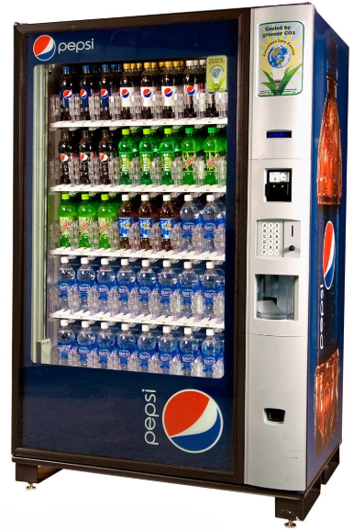
Cause–effect graph & Decision table
SOFTWARE QUALITY CONFERENCE
PACIFIC NW
The cause-effect graph: Design test cases by analyzing various combinations of input conditions graphically.
Example: Vending machine
Description: the vending machine software handles boxed drinks for $1.50 each.
If you put in $1.50 coins, press the "coke" or "Sprite” button,
the corresponding drink will be delivered.
If you put in $2 coins, return $0.5 coin with the beverage.

Slide 11
Cause–effect graph - Test cases design steps
SOFTWARE QUALITY CONFERENCE
PACIFIC NW
1). Determine the cause and effect in the requirements.
2). Determine the constraints between inputs.
# | Cause / Input | # | Effect / Output
C1 | Put in $1.50 coins | E1 | Refund $0.50 coin
C2 | Put in $2 coins | E2 | Dispense Coke
C3 | Press the "Coke" button | E3 | Dispense Sprite
C4 | Press the "Sprite" button
# | Cause / Input | Constraints
C1 | Put in $1.50 coins | Exclusive: Either C1 or C2
C2 | Put in $2 coins
C3 | Press the "Coke" button | Exclusive: Either C3 or C4
C4 | Press the "Sprite" button
XBOSoft

Slide 12
Cause–effect graph - Test cases design steps
SOFTWARE QUALITY CONFERENCE
PACIFIC NW
3). Determine the causality between input and output.
# | Cause / Input | # | Middle status | # | Effect / Output
C1 | Put in $1.50 coins | Cm1 | Coin-in | E1 | Refund $0.50 coin
C2 | Put in $2 coins |  |  | E2 | Dispense Coke
C3 | Press the "Coke" button | Cm2 | Pressed | E3 | Dispense Sprite
C4 | Press the "Sprite" button
XBOSoft

Slide 13
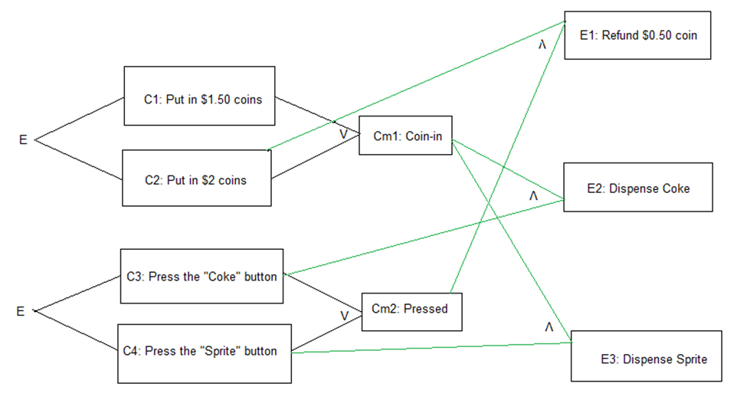
Cause–effect graph - Test cases design steps
SOFTWARE QUALITY CONFERENCE
PACIFIC NW
4). Draw the cause-effect graph.
XBOSoft

Slide 14
Decision table - Test cases design steps
SOFTWARE QUALITY CONFERENCE
PACIFIC NW
5). Convert graph to a decision table.
a. Take the values of C1, C2, C3 and C4 from small to large in binary system.
 | Cause / Input
# | C1 | C2 | C3 | C4
1 | 0 | 0 | 0 | 0
2 | 0 | 0 | 0 | 1
3 | 0 | 0 | 1 | 0
4 | 0 | 0 | 1 | 1
5 | 0 | 1 | 0 | 0
6 | 0 | 1 | 0 | 1
7 | 0 | 1 | 1 | 0
8 | 0 | 1 | 1 | 1
9 | 1 | 0 | 0 | 0
10 | 1 | 0 | 0 | 1
11 | 1 | 0 | 1 | 0
12 | 1 | 0 | 1 | 1
13 | 1 | 1 | 0 | 0
14 | 1 | 1 | 0 | 1
15 | 1 | 1 | 1 | 0
16 | 1 | 1 | 1 | 1
XBOSoft

Slide 15
Decision table - Test cases design steps
SOFTWARE QUALITY CONFERENCE
PACIFIC NW
b. Analyze whether the intermediate results are valid or not.
 | Cause / Input |  |  |  | Middle
# | C1 | C2 | C3 | C4 | Cm1 | Cm2
1 | 0 | 0 | 0 | 0 | N | N
2 | 0 | 0 | 0 | 1 | N | N
3 | 0 | 0 | 1 | 0 | N | N
4 | 0 | 0 | 1 | 1 | N | N
5 | 0 | 1 | 0 | 0 | N | N
6 | 0 | 1 | 0 | 1 | Y | Y
7 | 0 | 1 | 1 | 0 | Y | Y
8 | 0 | 1 | 1 | 1 | Y | N
9 | 1 | 0 | 0 | 0 | Y | N
10 | 1 | 0 | 0 | 1 | Y | Y
11 | 1 | 0 | 1 | 0 | Y | Y
12 | 1 | 0 | 1 | 1 | Y | N
13 | 1 | 1 | 0 | 0 | N | N
14 | 1 | 1 | 0 | 1 | N | N
15 | 1 | 1 | 1 | 0 | N | N
16 | 1 | 1 | 1 | 1 | N | N
XBOSoft

Slide 16
Decision table - Test cases design steps
SOFTWARE QUALITY CONFERENCE
PACIFIC NW
c. Obtain the following simplified version (that is, when intermediate results Cm1 and Cm2 are true).
 | Cause / Input |  |  |  | Effect / Output
# | C1 | C2 | C3 | C4 | E1 | E2 | E3
1 | 0 | 1 | 0 | 1 | T | F | T
2 | 0 | 1 | 1 | 0 | T | T | F
3 | 1 | 0 | 0 | 1 | F | F | T
4 | 1 | 0 | 1 | 0 | F | T | F
XBOSoft

Slide 17
Decision table - Test cases design steps
SOFTWARE QUALITY CONFERENCE
PACIFIC NW
6). Design test cases from decision table.
# | Input | Expected Result
1 | Put in $2 coins, Press the "Sprite" button. | Refund $0.50 coin, Dispense Sprite
2 | Put in $2 coins, Press the "Coke" button. | Refund $0.50 coin, Dispense Coke
3 | Put in $1.5 coins, Press the "Sprite" button. | Dispense Sprite
4 | Put in $1.5 coins, Press the "Coke" button. | Dispense Coke
XBOSoft

Slide 18
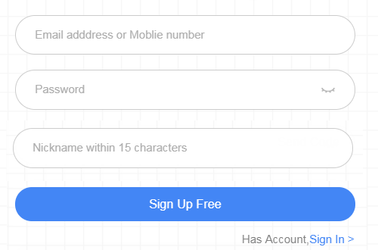
Orthogonal array testing
SOFTWARE QUALITY CONFERENCE
PACIFIC NW
An orthogonal table is a special form, usually expressed as Ln(m^k), n = k * (m - 1) + 1.
Example: Sign up a account
XBOSoft

Slide 19
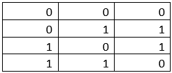
Orthogonal array testing
SOFTWARE QUALITY CONFERENCE
PACIFIC NW
Test cases design steps:
1). Analyze the factors (variables): Username, Password, Confirm Password.
2). Value of variable: Yes (fill in), No (not fill in).
3). Choose an appropriate orthogonal table: here we use L4(2^3).
Reference:
Orthogonal table online: https://www.york.ac.uk/depts/maths/tables/orthogonal.htm
XBOSoft

Slide 20
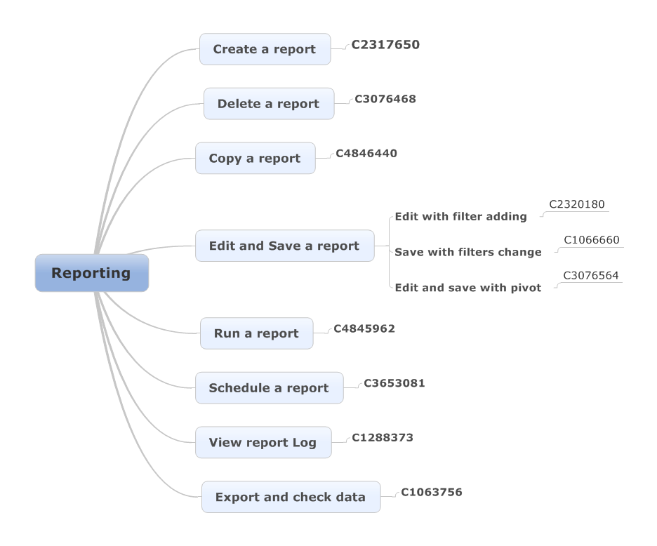
Functional structure diagram
SOFTWARE QUALITY CONFERENCE
PACIFIC NW
Function structure diagram is used to show the dependency of functions, it is also a feature breakdown structure diagram.
Example：
XBOSoft

Slide 21
Conclusions
SOFTWARE QUALITY CONFERENCE
PACIFIC NW
Here are some general principles for when to use which test design techniques.
1. If the variables are independent, you can divide the domain and use equivalence partitioning. Turn an infinite number of tests into a finite number of tests.
2. Boundary value analysis is a method that used in any software test.
3. If the combination of input conditions needs to be considered, the causal graph method and the decision table method can be used
4. If the relationships between inputs and outputs are large, orthogonal array method can be used to reduce test cases.
5. If the functionalities of a system are complicated, functional structure can be used to breakdown functionalities.
6. Check the designed test case logic coverage against the program logic, and add enough test cases if the required coverage standards are not met.
XBOSoft

Slide 22
Closing Reference Slide
SOFTWARE QUALITY CONFERENCE
PACIFIC NW
How to contact author: liu.subei@xbosoft.com
Links to Company Author is Employed by: https://www.xbosoft.com
XBOSoft

